Slide 1
2015

Slide 2

www.evian-plongee.fr

Slide 3

www.evian-plongee.fr

Slide 4
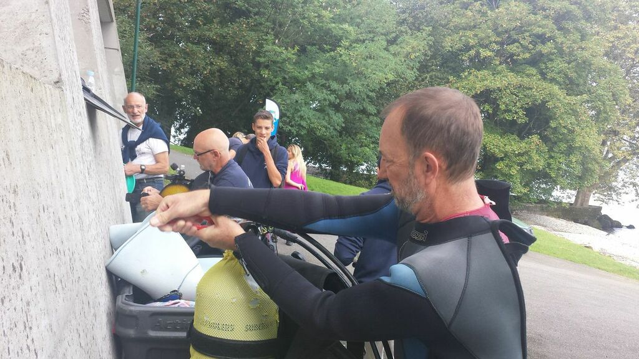
www.evian-plongee.fr

Slide 5
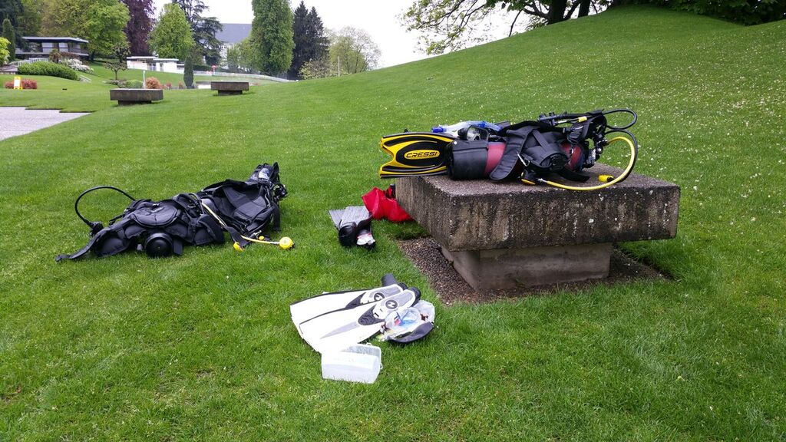
www.evian-plongee.fr

Slide 6
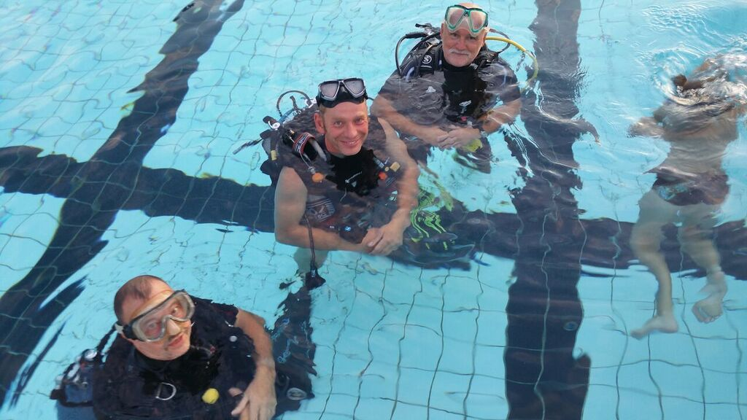
www.evian-plongee.fr

Slide 7
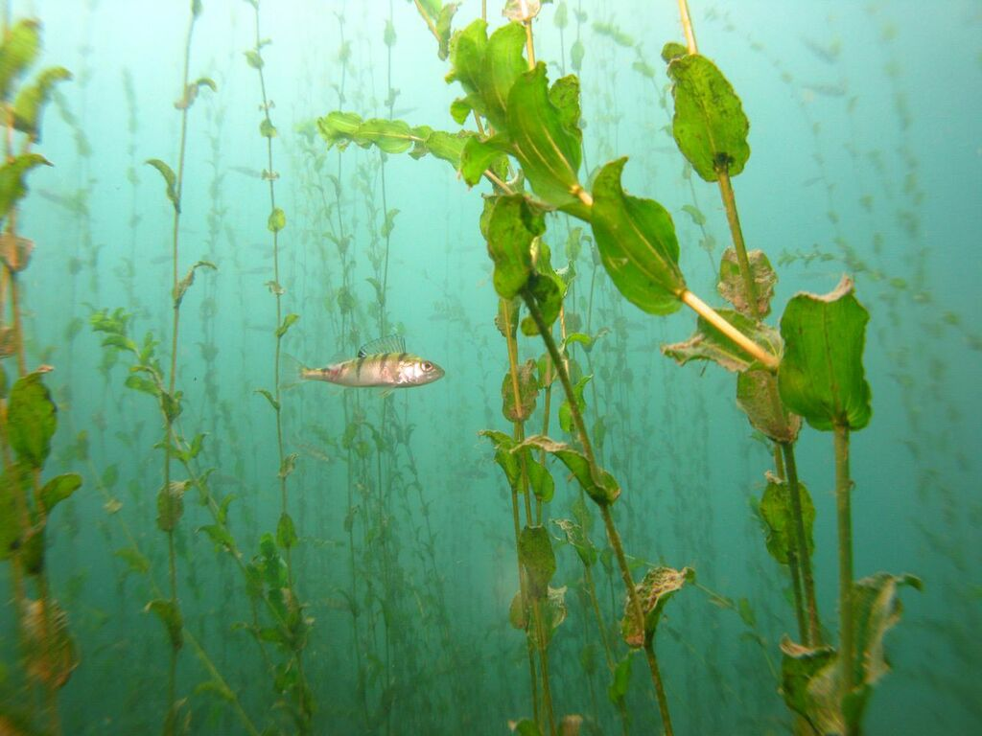
www.evian-plongee.fr

Slide 8
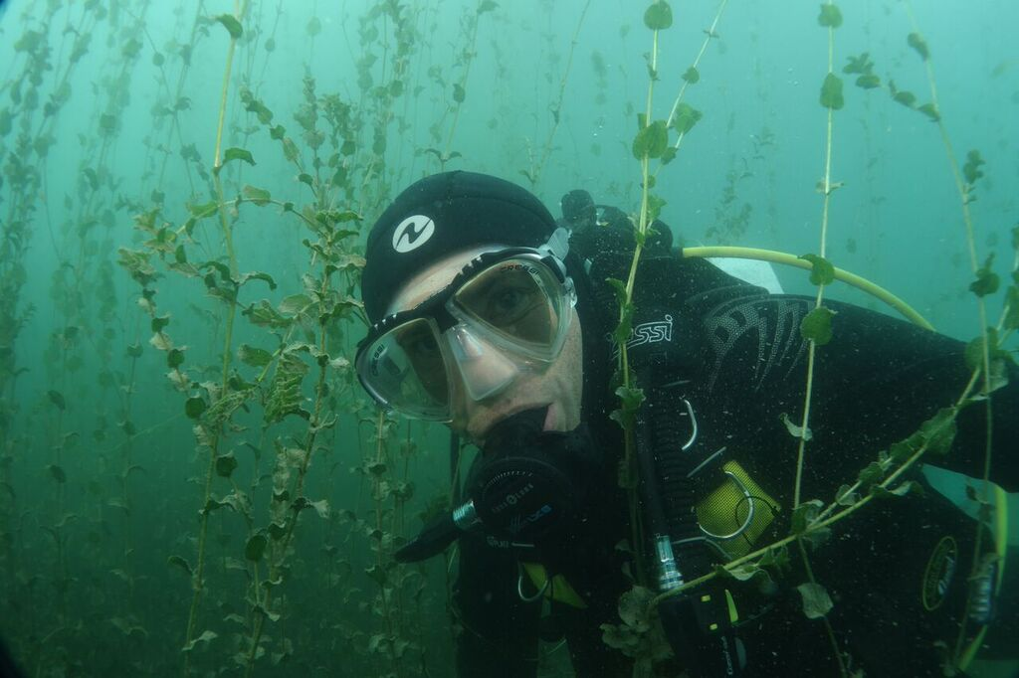
www.evian-plongee.fr

Slide 9
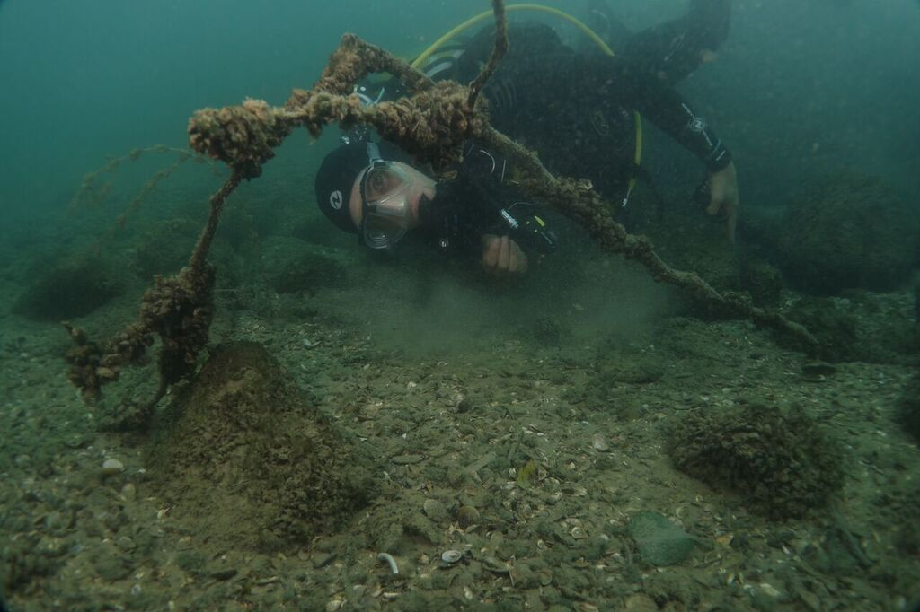
www.evian-plongee.fr

Slide 10
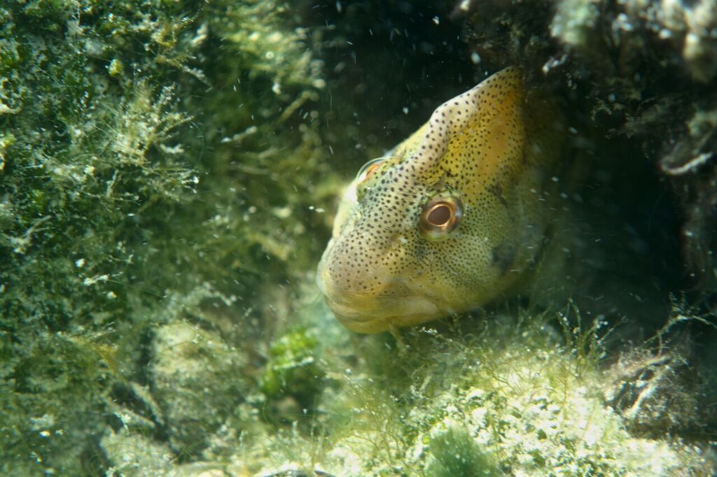
www.evian-plongee.fr

Slide 11
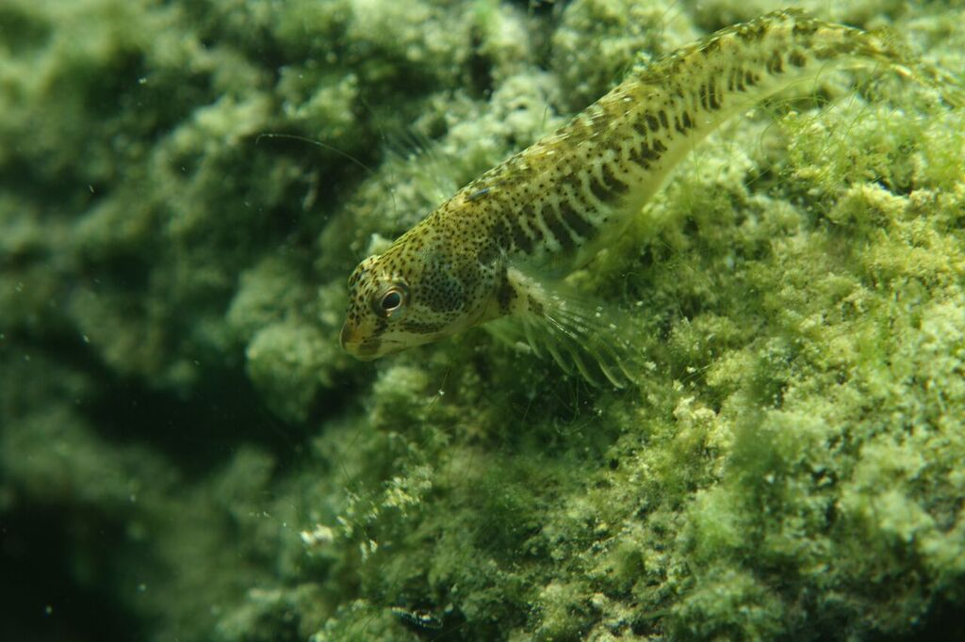
www.evian-plongee.fr

Slide 12

www.evian-plongee.fr

Slide 13
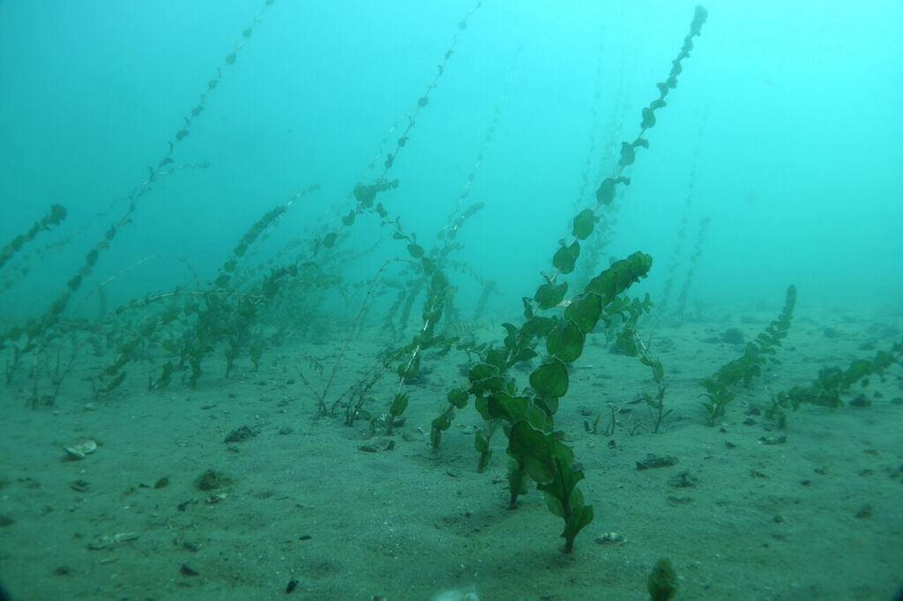
www.evian-plongee.fr

Slide 14
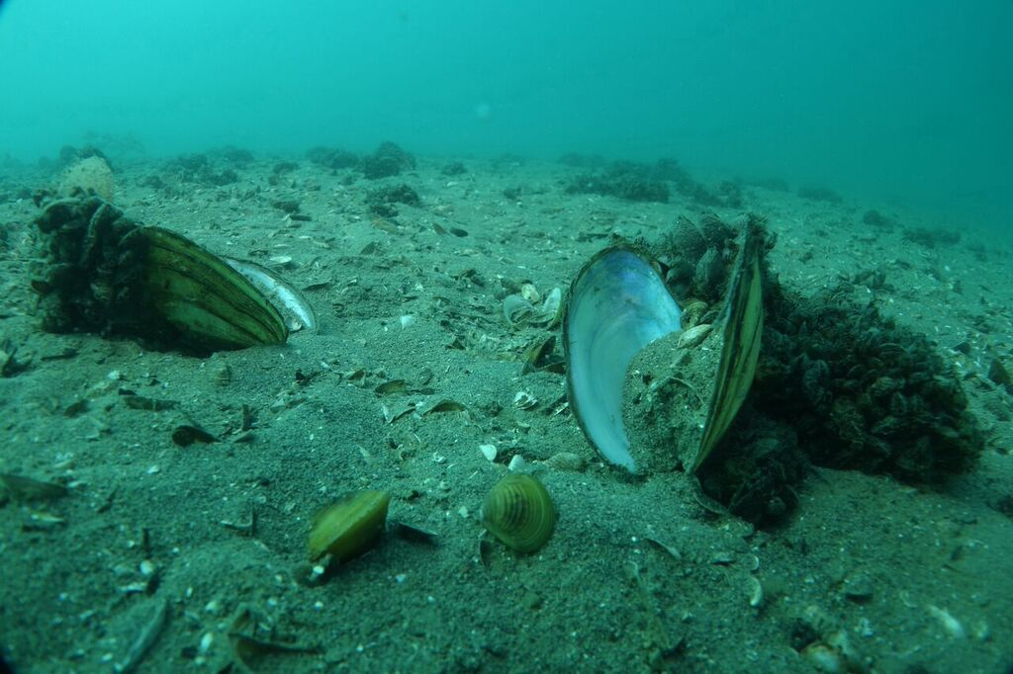
www.evian-plongee.fr

Slide 15
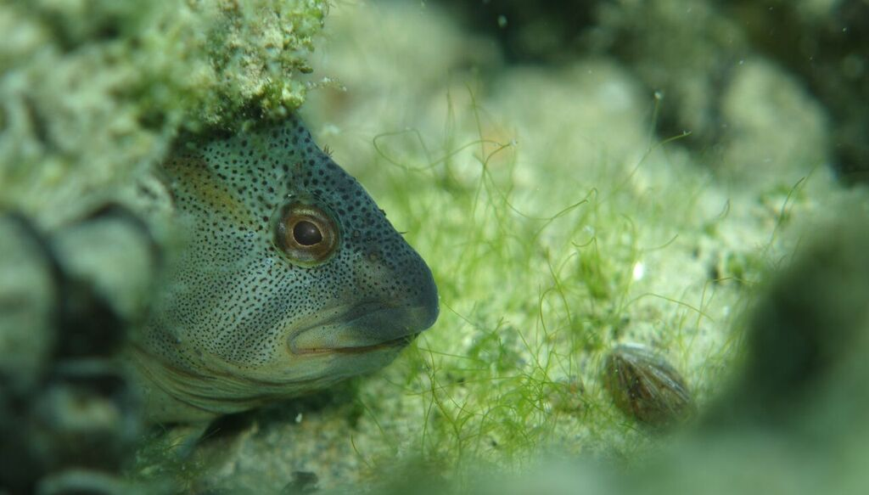
www.evian-plongee.fr

Slide 16
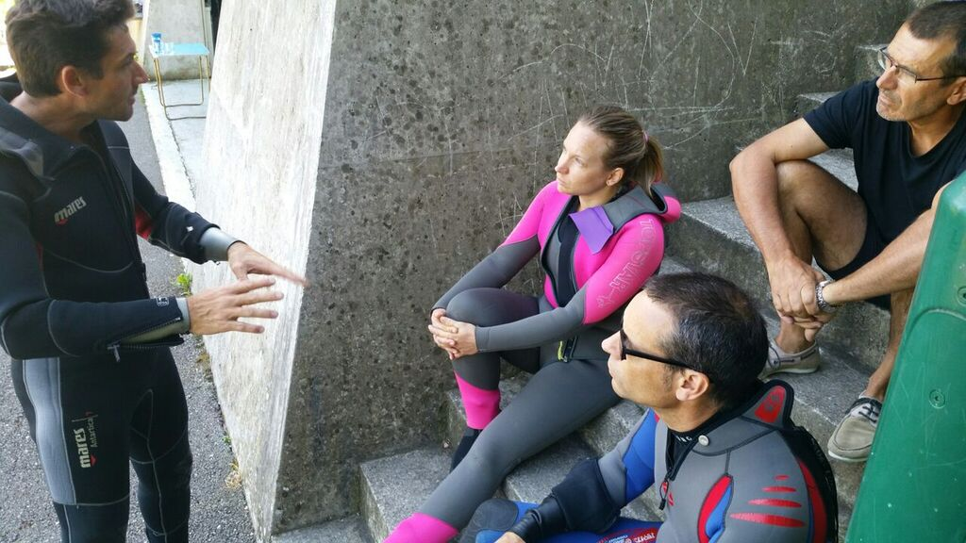
www.evian-plongee.fr

Slide 17
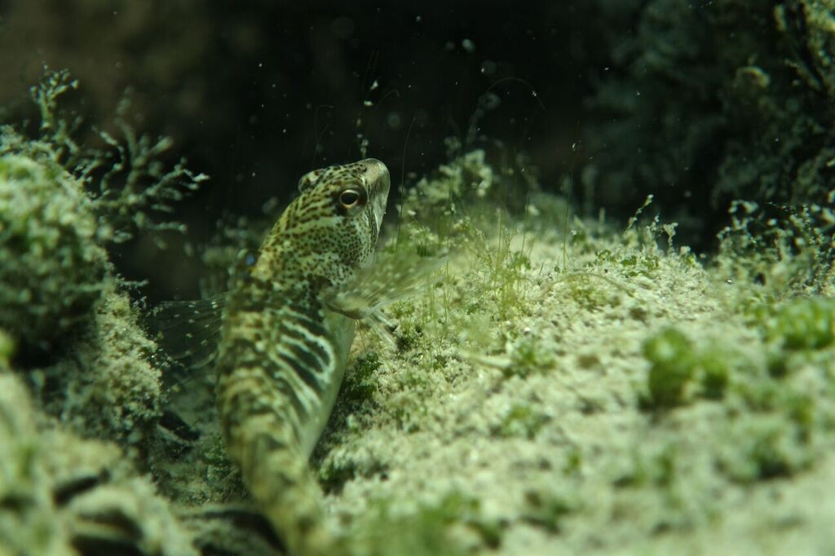
www.evian-plongee.fr

Slide 18

www.evian-plongee.fr

Slide 19

www.evian-plongee.fr

Slide 20
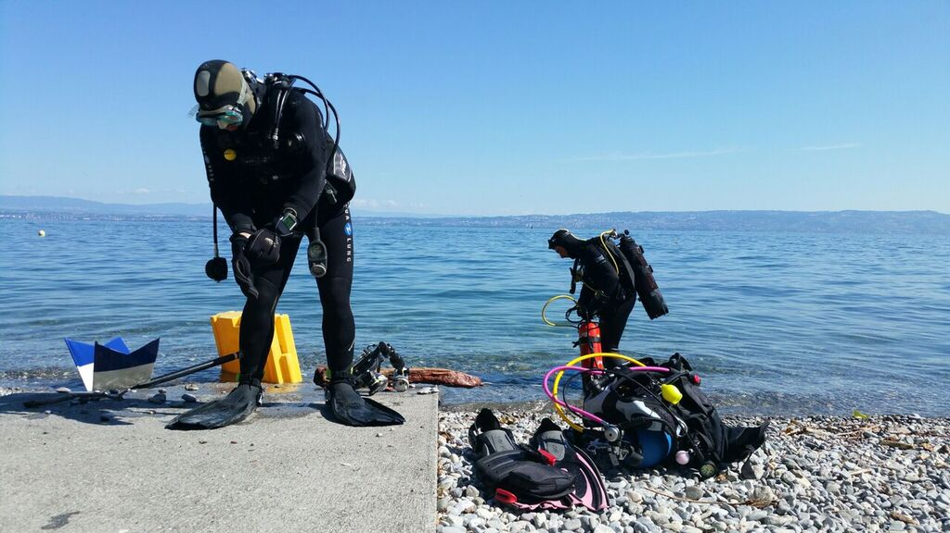
www.evian-plongee.fr

Slide 21

www.evian-plongee.fr

Slide 22
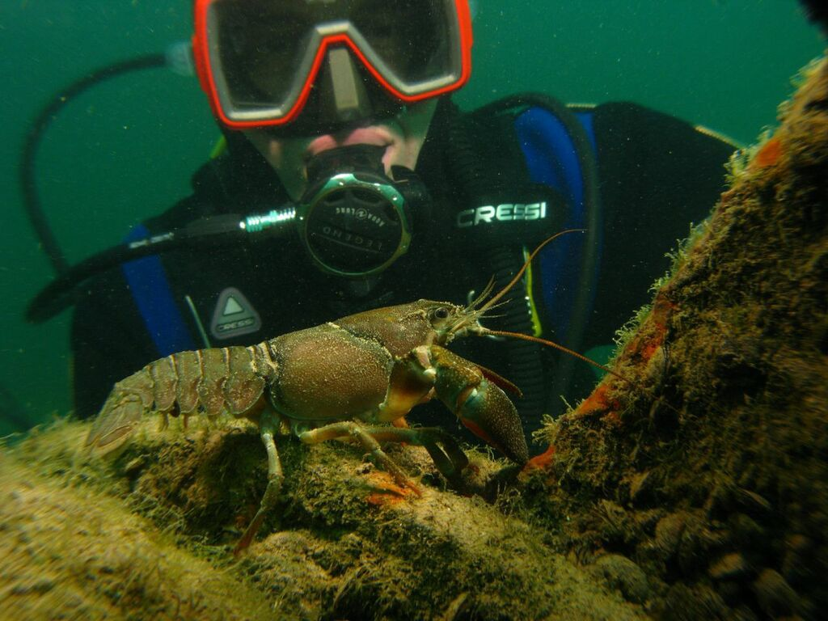
www.evian-plongee.fr

Slide 23
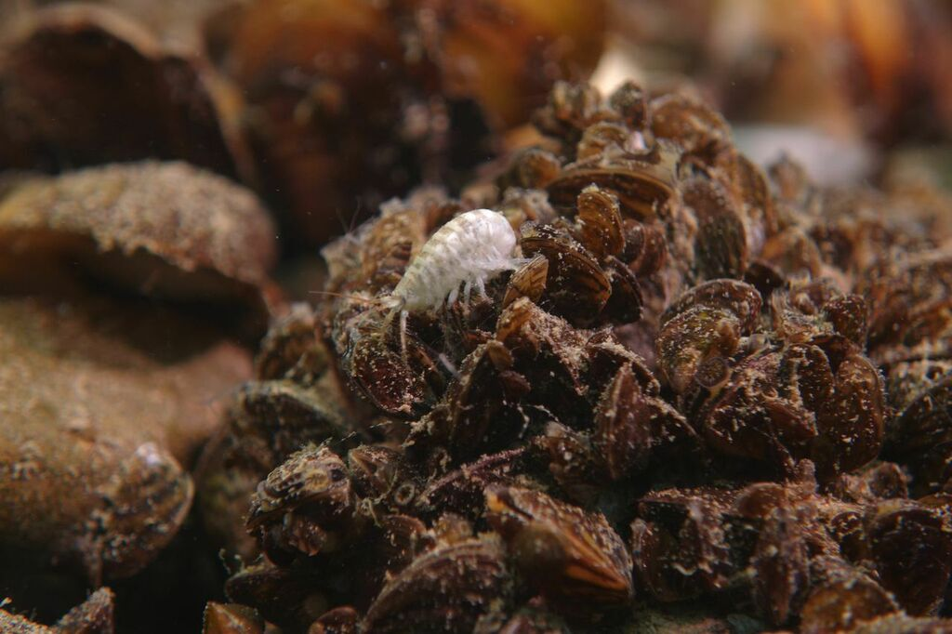
www.evian-plongee.fr

Slide 24
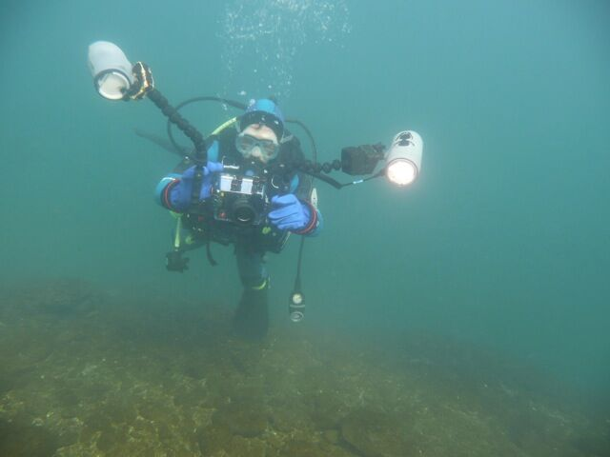
www.evian-plongee.fr

Slide 25
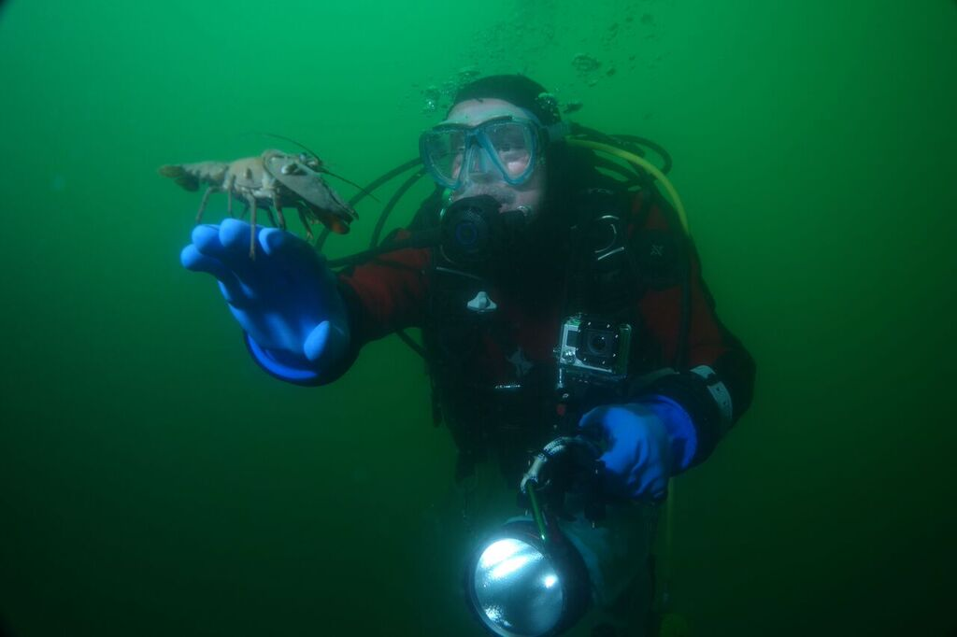
www.evian-plongee.fr

Slide 26
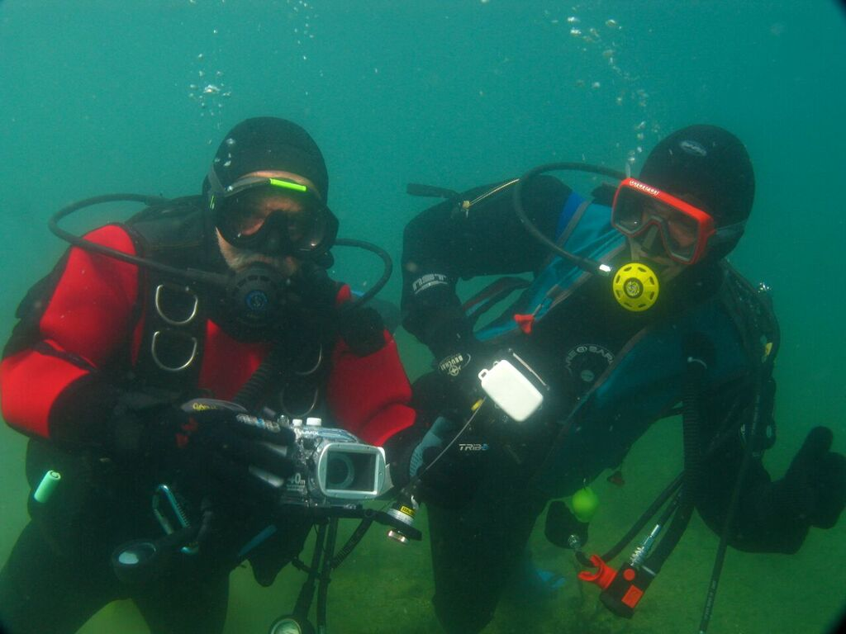
www.evian-plongee.fr

Slide 27

www.evian-plongee.fr

Slide 28
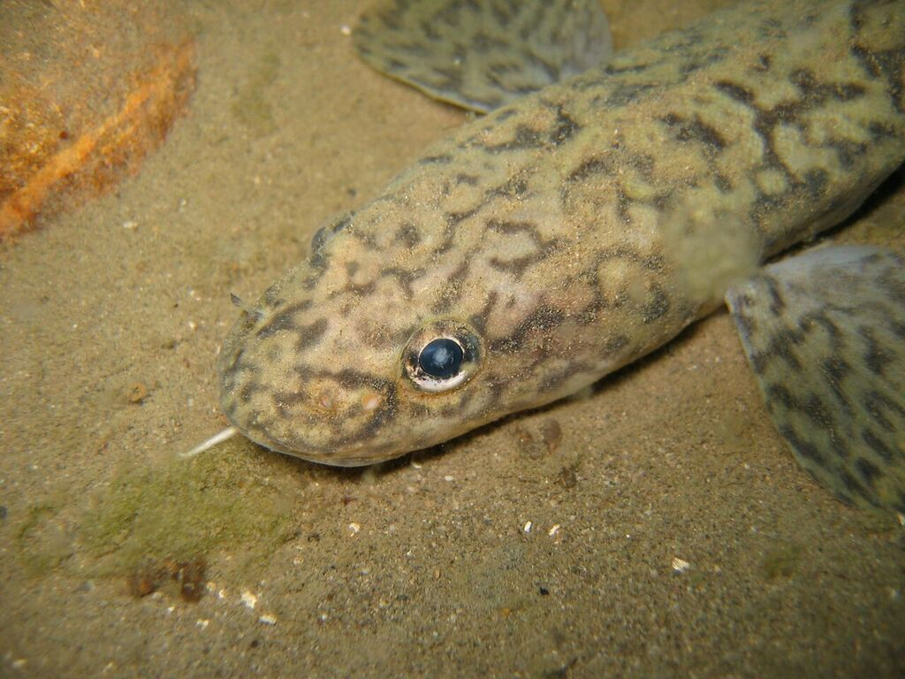
www.evian-plongee.fr

Slide 29
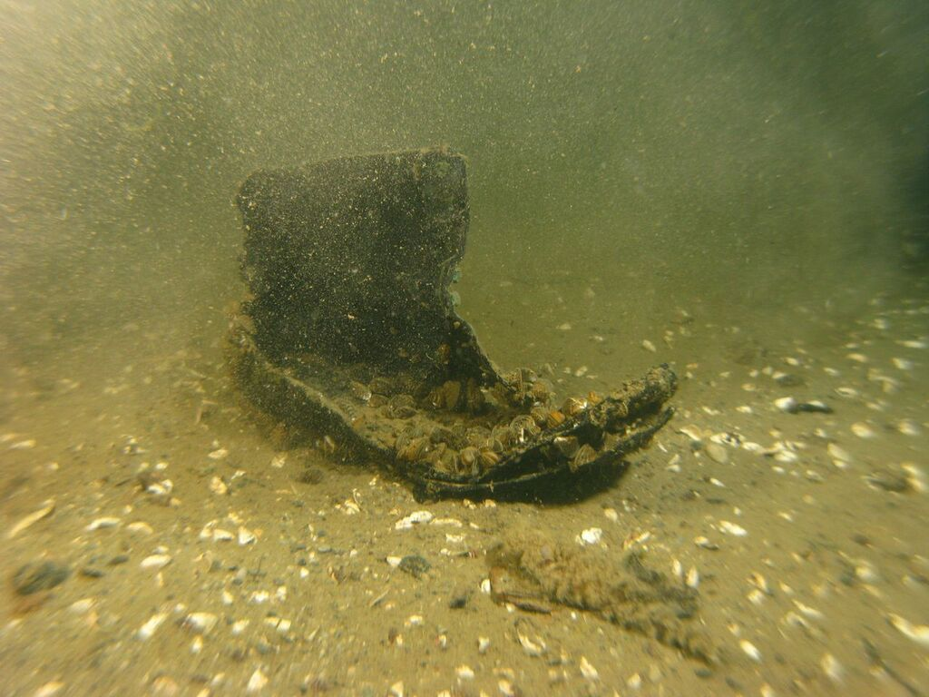
www.evian-plongee.fr

Slide 30

www.evian-plongee.fr

Slide 31
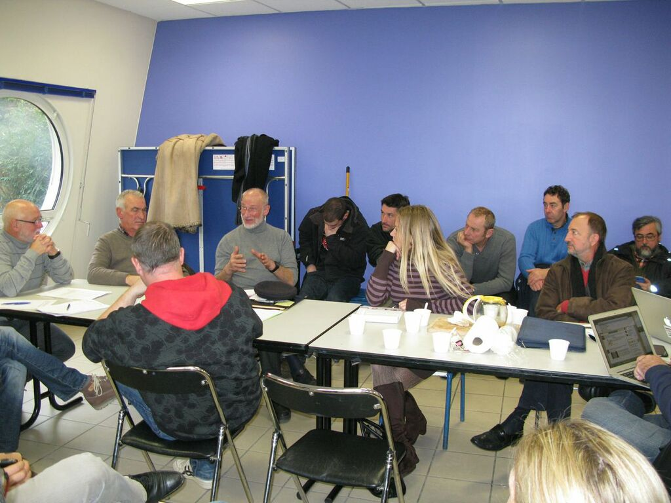
www.evian-plongee.fr

Slide 32
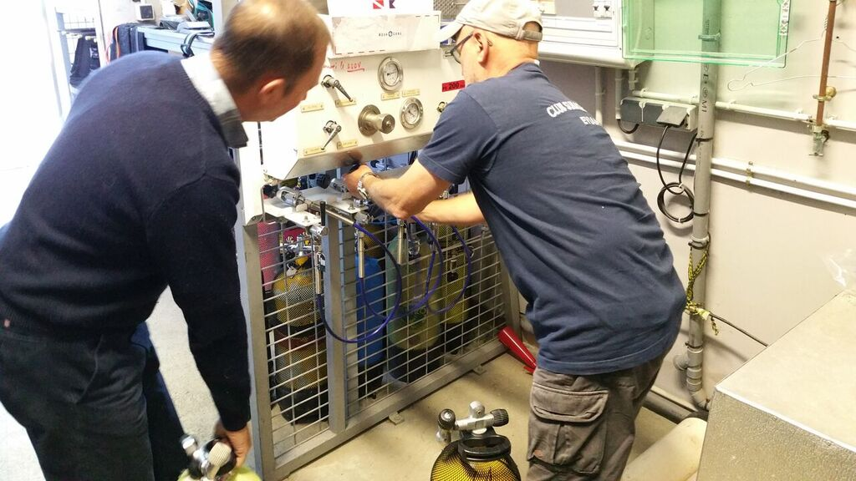
www.evian-plongee.fr

Slide 33

www.evian-plongee.fr

Slide 34
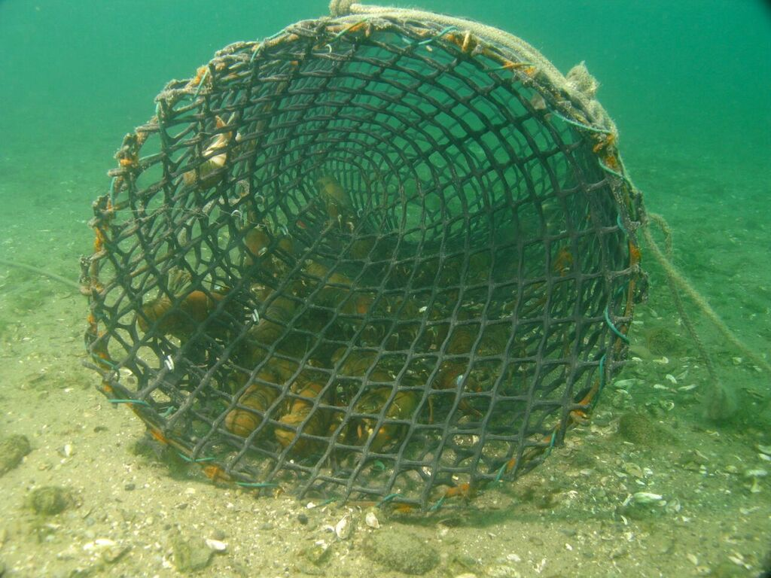
www.evian-plongee.fr

Slide 35
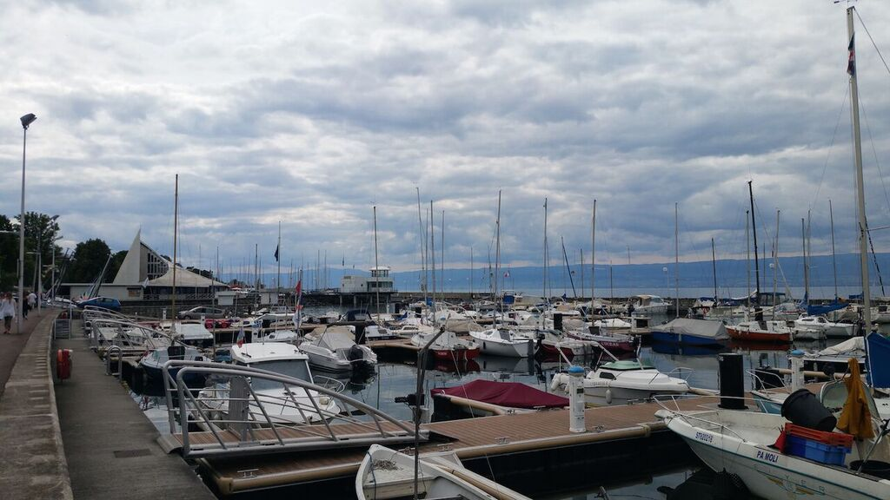
www.evian-plongee.fr

Slide 36
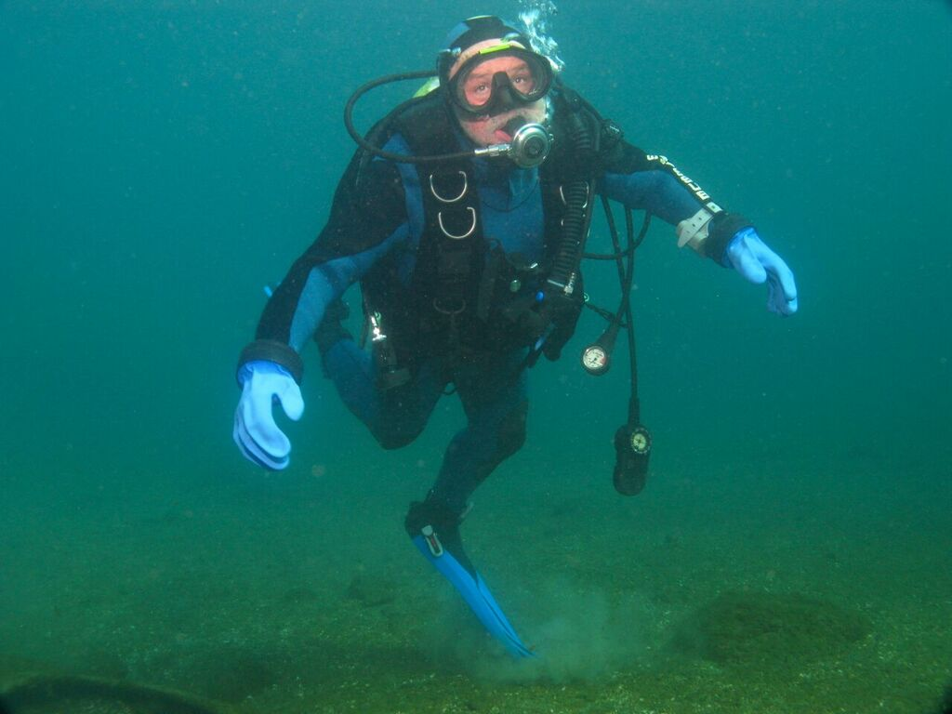
www.evian-plongee.fr

Slide 37
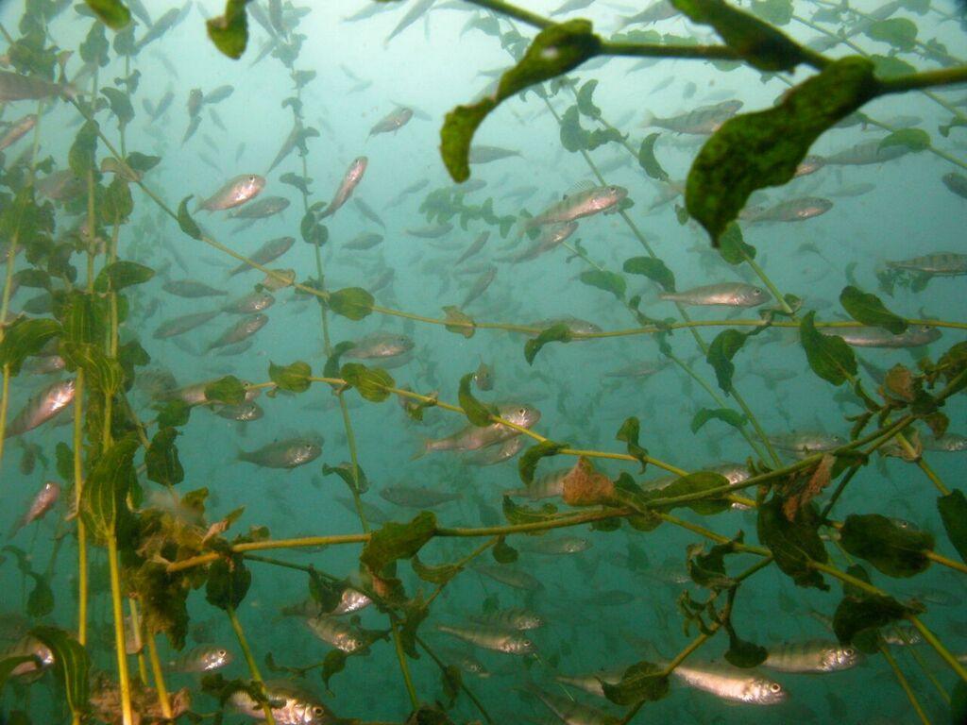
www.evian-plongee.fr

Slide 38

www.evian-plongee.fr

Slide 39
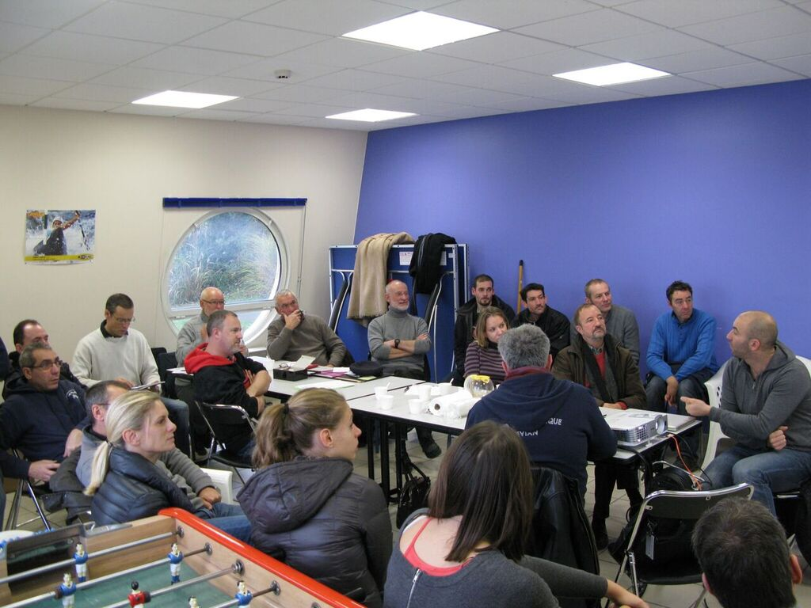
www.evian-plongee.fr

Slide 40
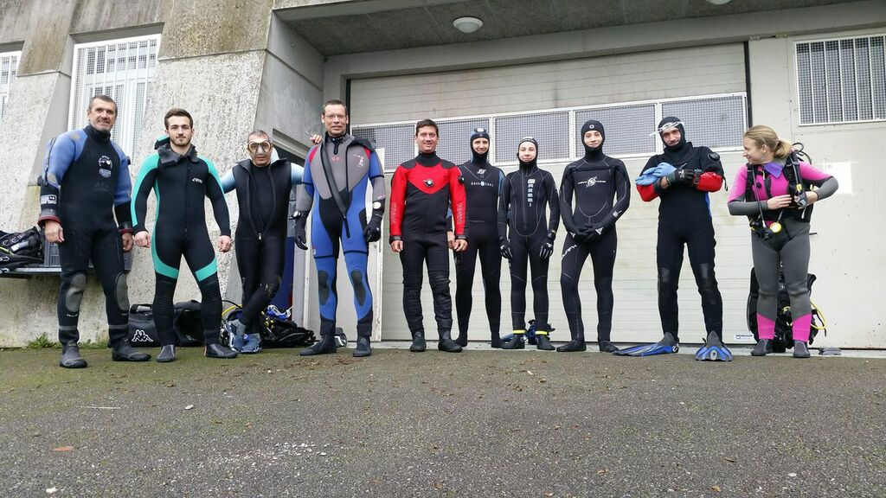
www.evian-plongee.fr

Slide 41
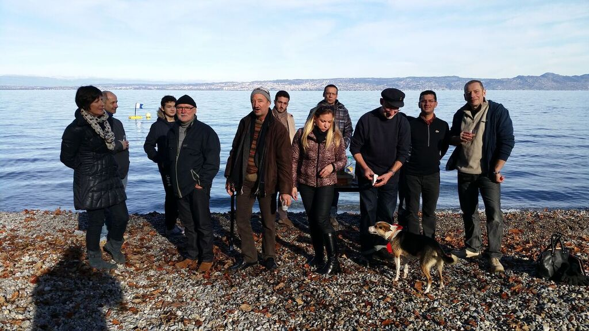
www.evian-plongee.fr

Slide 42
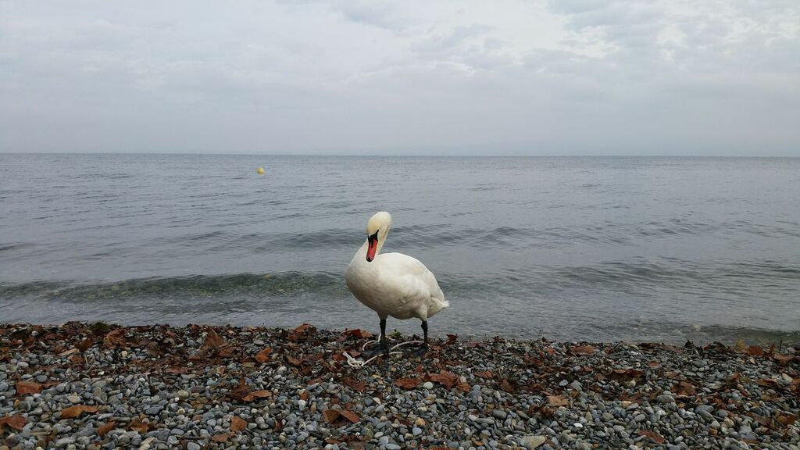
www.evian-plongee.fr

Slide 43
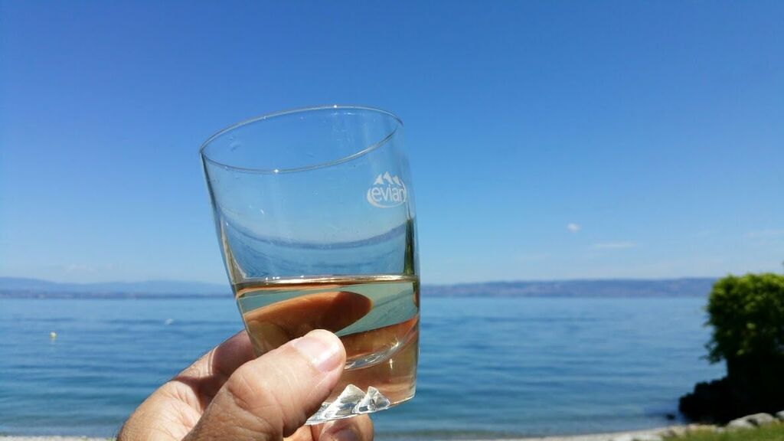
www.evian-plongee.fr

Slide 44
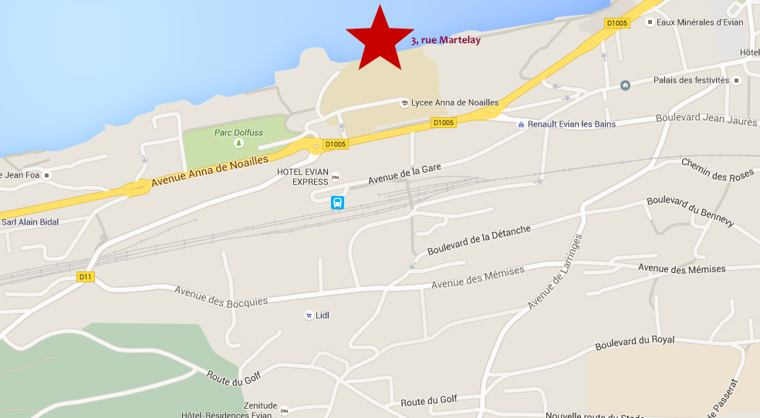
www.evian-plongee.fr

Slide 45
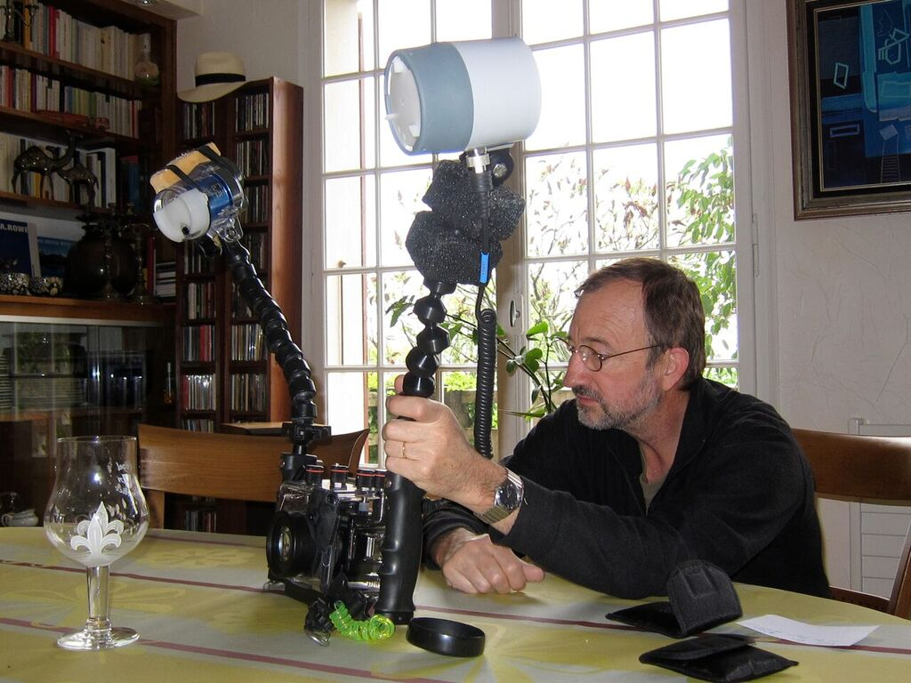
www.evian-plongee.fr

